Slide 1

Case Study Presentation

Slide 2

Data Cleaning-Garbage in, Garbage out

Slide 3
Data Cleaning
Eliminated redundant attributes
Renamed the attributes
Blank cells with NA(Not applicable)

Slide 4
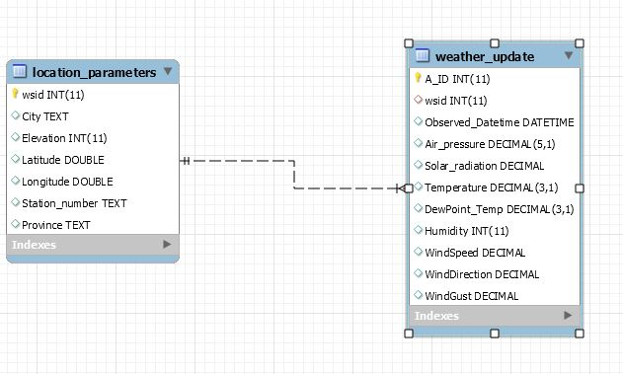
Data Model

Slide 5

Recorded Observation :MySQL faster than MongoDB for smaller records

Slide 6
Observation (Raw Data)
Limited on 5000
Limited on 10000

Slide 7
Observation (Raw data)
Limited on 15000
Limited on 90000

